Slide 1
Teachers Teaching Teachers – Build and Encourage
Kathy Spruiell
Arcado Elementary School, Lilburn GA

Slide 2
Let’s set the NORMS…
Parking Lot
Attention Signal
Materials, Copies, PPT, etc…
Over 21 Rule
This is not “Sit and Get.”
Anything Else???
770-842-5200
www.mrsspruiellatschool.weebly.com
Mathkathy.spruiell@gmail.com

Slide 3
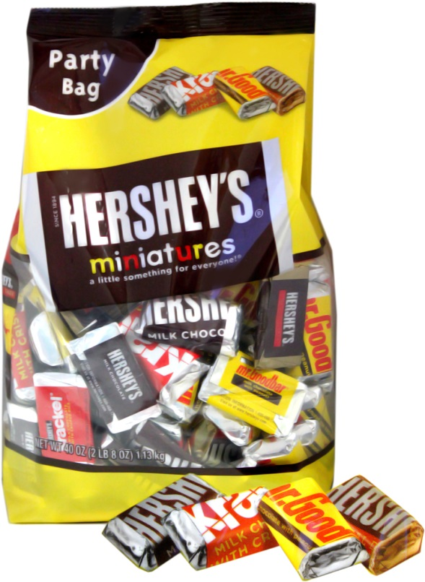
Ice Breaker – Chocolate Personalities
If you choose: Here are the characteristics that describe you...
Milk Chocolate | You're an all American who loves baseball, Mom & apple pie. You're a cheerleader for your program, level-headed, a good PR person and a great fundraiser. You're also kind, thoughtful, and always remember everyone's birthday. You are nurturing, dependable, loyal, and help others to "shine". Others often turn to you for help.
Krackel | You're creative, optimistic, always see the cup as half full. You're messy (messy desk or classroom) but organized (eventually find a missing item or believe you will). You like to be a hands-on person. You're a little off-beat, ditzy, funny, friendly and outgoing person who is always will to help. You like the surprising things in life, the "krackel". You like situations that allow flexibility, change and growth.
Mr. Goodbar | You're analytical and logical. You gather data first before giving an opinion, play the devil's advocate at meetings, tend to see all the possibilities and drive people crazy by sharing all the "what ifs". You hate deadlines and put off starting things; you're a procrastinator. You like to be the expert but in your own time frame. You can analyze things to death. You like there to be rules that everyone follows. You like a lot of structure and hate surprises.
Special Dark | You're a patient, thoughtful individualist and problem-solver. You like to see a project through from start to finish. You're a good grant writer and work well with difficult people. You are reflective and insightful and have little patience for incompetence or liars. You set high standards for yourself and others. You are dependable, resourceful, and loyal.

Slide 4
Teacher Teaming – Peer Coaching
The Stages of Team Development | Framework for Changing Practice | Teachers Support Each Other– Peer-Coach
Forming | Stage 1 - Awareness | Obtains Buy-in
Storming | Stage 2 – For Change | Initiates structures to support school
Norming | Stage 3 – To Change | Builds relationships
Performing | Stage 4 - Change | Develops internal expertise, Cultivates team learning as a shared goal, Keeps focus on improvement
Informing | Stage 5 – Sustaining Change | Facilitates on-going collaboration and teacher leadership, Nurtures a sense of shared responsibility and accountability, Promotes the use of conscious reflection

Slide 5
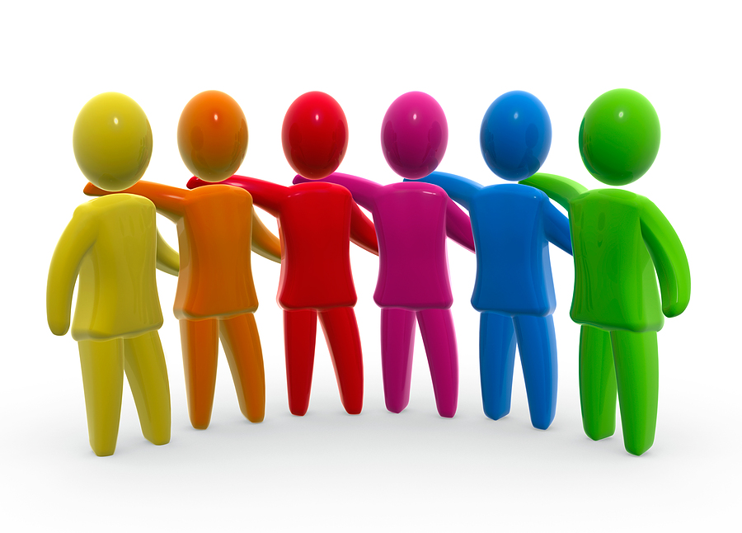
Where do we start?
Know your team
Build Trust
Know your passion
Build on strengths
Use research
Capitalize on the Positive
Reflect

Slide 6
2. Who ARE you??”
Personality Types
Learning Styles
Placemats
www.mrsspruiellatschool.weebly.com

Slide 7
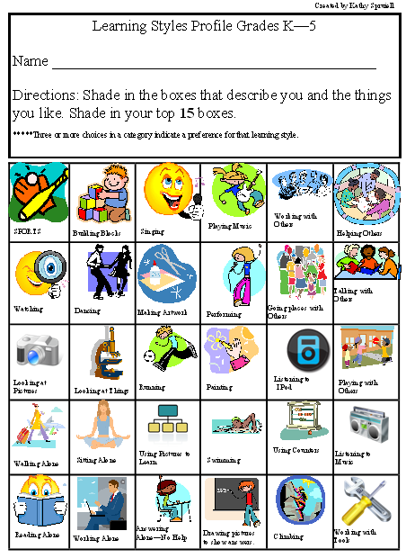
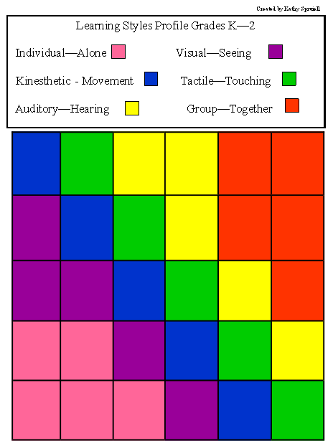
Learning Styles

Slide 8
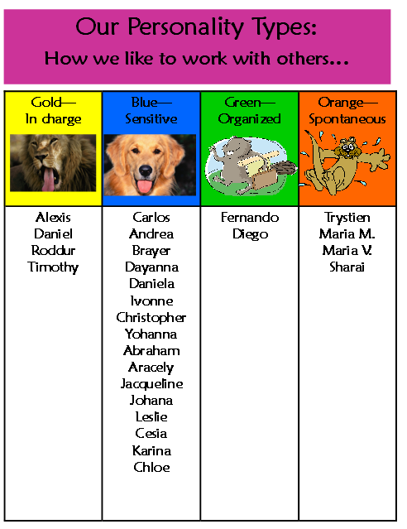
Personality Corners

Slide 9
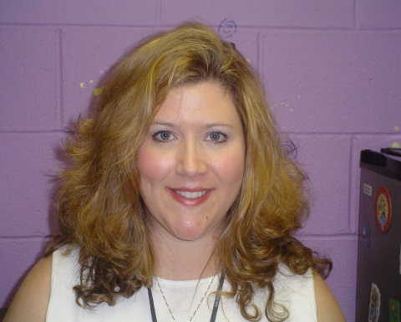
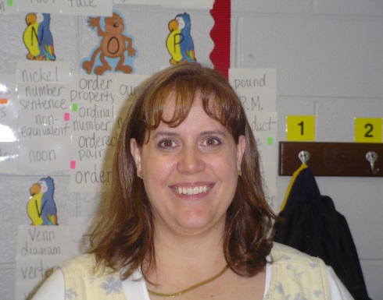
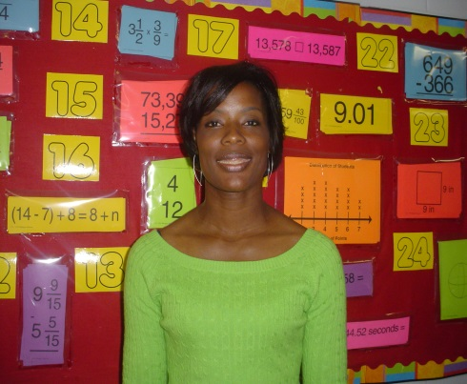
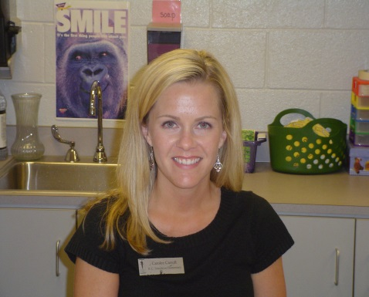
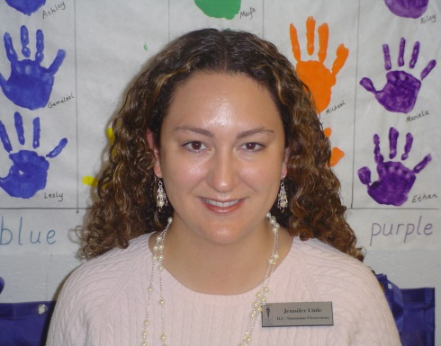
Starting Small a True Story…..

Slide 10
Use the Research
Jigsaw
Article: “Building Trust”
Article: “A Tale of 3 Teachers”
Article: “Elementary Mathematics Leaders”
Article: “From Teaching to Coaching”

Slide 11
Stay Positive
Do It Anyway by Mother Teresa
People are often unreasonable, illogical and self-centered; Forgive them anyway.
If you are kind, people may accuse you of selfish ulterior motives; Be kind anyway.
If you are successful, you will win some false friends and true enemies; Succeed anyway.
If you are honest and frank, people may cheat you; Be honest anyway.
What you spend years building, someone could destroy overnight; Build anyway.
If you find serenity and happiness, they may be jealous; Be happy anyway.
The good you do today, people will often forget tomorrow; Do good anyway.
Give the world the best you have, and it may never be enough; Give the world the best you’ve got anyway.
You see, in the final analysis, it is between you and God; It was never between you and them anyway.

Slide 12
Reflect
What will you immediately implement?
How will you do it?
Who will support you?

Slide 13
Validate and Celebrate!!
Favorites:
Sparkles for YOU!!
Fireworks
Round of Applause
Fantastic
Cheese Grater
Refreshing
Good Job Good Buddy
OH Yeah!!
Did a Good Job
That’s the way I like it.
Kiss Your brain!

Slide 14
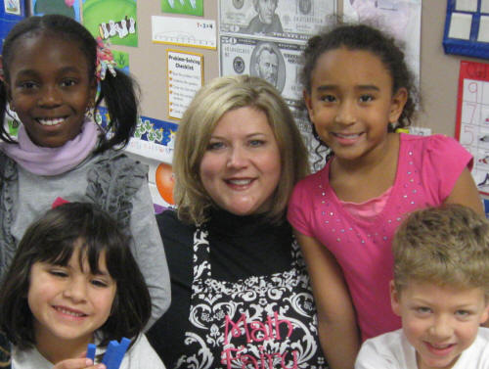
Contact Information
For more information on this presentation, contact:
Kathy Spruiell, Ed.S.
Teacher/Math Coach Consultant
Arcado Elementary School
5150 Arcado Road
Lilburn, GA 30047
(770) 842-5200
mathkathy.spruiell@gmail.com
www.mrsspruiellatschool.weebly.com

